Slide 1

Louisiana Coordinated System of Care
Provider Billing – Youth Mobile Crisis and Community Brief Crisis Support

Slide 2
Authorizations and
Submission of claims

Slide 3

Service Authorization
The following Mobile Crisis services will not require an authorization for services:
Mobile Crisis Response – initial contact S9485 TG, U8
  The initial MCR dispatch per diem covers the first 24 hours. All follow-ups should be based on a clinical individualized need. There should be no limits placed on MCR follow-up other than MCR follow-up being allowed beyond the initial 24 hours and up to 72 hours after dispatch.
Mobile Crisis Response – Telehealth Follow-up H2011 TG,95
Mobile Crisis Response – Community-Based Follow-up H2011 TG, U8

Slide 4
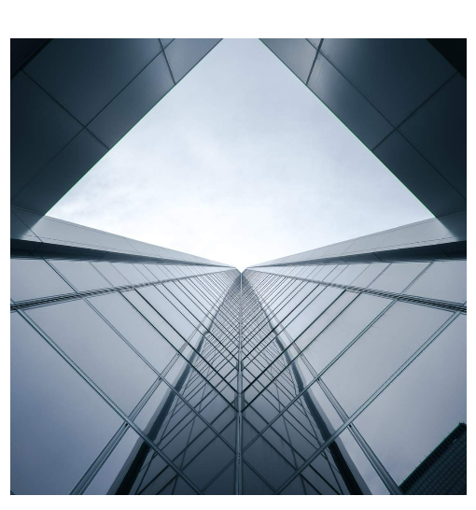
Service Authorization
Services that require an authorization:
Community Brief Crisis Support – H2011 HK
  Providers must use the number provided by Magellan on the LA Crisis Care Coordination Contact List -800-424-4489 Option 1 within one business day of beginning the service and units/hours will be based on the youth’s individualized need for no more than 15 days.
  Please be prepared to provide the following:
    Service start date
    Diagnosis
    Specific clinical information regarding the crisis including triggers, symptoms, and interventions
  Magellan’s criteria for authorizing CBCS:
    The information noted above is required and, the provider must be listed on the plan of care (POC) for authorization to be issued
    An administrative authorization will be issued if the service is not on the POC, and the WAA will be contacted to submit an updated POC
Things to Know for CSoC
The Mobile Crisis provider must contact the youth’s Wraparound Agency following the initial crisis.
WAA contact information can be found here: Regional Wraparound Agencies | Magellan of Louisiana

Slide 5

Helpful tips
Help of your claims by:
Using the appropriate billing, procedure codes, and modifiers
  See Magellan agreement and reimbursement schedules
Submitting claims in a timely manner
If submitting on paper, using the appropriate claim form (CMS-1500)
Completing all required data on the form, including the Tax ID number and NPI number
Using the unit of service indicated on your Magellan contract
Help expedite the processing of your claims by:
Using the appropriate billing, procedure codes, unites and modifiers
Submitting claims in a timely manner – within 365 days of service
If submitting on paper, use the appropriate claim form (CMS-1500)
Completing all required data on the form, including the Tax ID number and NPI number
Using the unit of service indicated on your Magellan contract
Code | Description | Modifier | Unit | RATE
S9485 | MOBILE CRISIS RESPONSE - INITIAL CONTACT - Effective 4/1/24 | TG, U8 | Per Diem | $493.72
H2011 | MOBILE CRISIS RESPONSE - TELEHEALTH FOLLOW-UP - Effective 4/1/24 | TG, 95 | 15 Minutes | $29.09
H2011 | MOBILE CRISIS RESPONSE - COMMUNITY BASED FOLLOW UP - Effective4/1/24 | TG, U8 | 15 Minutes | $37.91
H2011 | COMMUNITY BRIEF CRISIS SUPPORT -Effective 4/1/24 | HK | 15 Minutes | $38.16

Slide 6
Diagnosis Codes
We understand that in many, if not most instances, you will not be able to appropriately assess for a definitive behavioral health diagnosis based on the initial MCR deployment alone. In these situations, the following codes can be used:
Z13.30 – encounter for screening examination for mental health and behavioral disorders, unspecified
Codes in the Z71 series, Persons encountering health services for other counseling and medical advice, not elsewhere classified, specifically:
  Z71.1 Person with feared health complaint in whom no diagnosis is made
  Z71.9 Counseling unspecified.
You can consider these diagnosis codes when submitting claims for mobile crisis service

Slide 7
Diagnosis Codes - continued
Begin Range | End Range |  | Begin Range | End Range |  | Begin Range | End Range
F1010 | F10120 |  | F1920 | F1990 |  | F15920 | F1599
F10129 | F10129 |  | F550 | F558 |  | F16121 | F1619
F1020 | F10220 |  | F1210 | F1210 |  | F16220 | F1629
F10229 | F10229 |  | F0150 | F09 |  | F16920 | F1699
F1110 | F11120 |  | F10121 | F10121 |  | F17203 | F17209
F11129 | F11129 |  | F1014 | F1019 |  | F17213 | F17219
F1120 | F1190 |  | F10221 | F10221 |  | F17223 | F17229
F1220 | F1290 |  | F10230 | F1099 |  | F17293 | F17299
F1310 | F13120 |  | F11121 | F11122 |  | F18120 | F1819
F1320 | F1390 |  | F1114 | F1119 |  | F18220 | F1829
F1410 | F14120 |  | F11220 | F1129 |  | F18920 | F1899
F1420 | F1490 |  | F11920 | F1199 |  | F19121 | F1919
F1510 | F15120 |  | F12120 | F1219 |  | F1921 | F1929
F1520 | F1590 |  | F12220 | F1229 |  | F19920 | F5103
F1610 | F16120 |  | F12920 | F1299 |  | F5109 | F5112
F1620 | F1690 |  | F13121 | F1319 |  | F5119 | F54
F17200 | F17201 |  | F13220 | F1329 |  | F59 | F804
F17210 | F17211 |  | F13920 | F1399 |  | F8089 | F840
F17220 | F17221 |  | F14121 | F1419 |  | F843 | F99
F17290 | F17291 |  | F14220 | F1429 |  | R37 | R37
F1810 | F18120 |  | F14920 | F1499 |  | R451 | R452
F1820 | F1890 |  | F15121 | F1519 |  | R455 | R4582
F1910 | F19120 |  | F15220 | F1529 |  | R480 | R480
You may also consider these diagnosis codes when submitting claims for mobile crisis service

Slide 8
Clean claims

Slide 9
Clean claims
What is a clean claim?
A clean claim has no defect, impropriety (including any lack of required substantiating documentation), or circumstance requiring special treatment that prevents timely payment of the claim. Simply put, clean claims are claims that can be processed without obtaining any additional information from the provider or from a third party.
Provider submits a clean claim through:
Availity Essentials
EDI via Magellan
An accepted clearinghouse with Payer ID 01260
Paper claim and Availity Essentials
  Postal address:
  Magellan Healthcare, Inc.
  P.O. Box 1749
  Maryland Heights, MO 63043

Slide 10

Claims requirements
Submit claims for reimbursement within the limits required by the state of Louisiana.
Bill using your contracted Taxpayer Identification Number.
Submit claims with agency NPI as the billing provider and licensed or unlicensed staff NPI as the rendering provider.
Maintain up-to-date roster staff to avoid claim processing delays and/or denials.
When submitting claims for services conducted via telehealth be sure to submit the claim with the place of service 10 when the youth is in the home or 02 when the youth is in a location other than home. Telehealth modifier 95 is required.
Hold the youth harmless and not bill the youth for any amount, including the difference between Magellan’s reimbursement amount and your standard rate. This practice is called balance billing and is prohibited.
You must submit clean claims within 90 calendar days of the date of service or discharge.

Slide 11





Clean claims
When submitting a claim, consider the following:
Am I submitting claims correctly?
Am I submitting claims timely?
Did I verify youth eligibility?
Do I have the correct service location?
(rendering address and place of service)

Slide 12


Claims questions
Contact Magellan at 1-833-396-4310 if you are not certain which services require preauthorization, what your reimbursement rate is, or for any questions that you have concerning claims payment.
Refund any overpayments by mailing a check and documentation of the youth identification number and date of service to:
Magellan Healthcare, Inc. Recoveries Lockbox
P.O. Box 785346
Philadelphia, PA 19178-5346

Slide 13


Magellan reimbursements
Magellan is committed to reimbursing our providers promptly and accurately in accordance with our contractual agreements. Magellan reimburses behavioral health, substance use treatment providers, and Mobile Crisis providers in accordance with reimbursement schedules for professional services.
The reimbursement schedule(s) is attached to your Magellan provider agreement. We will process your claims promptly and respond to your claims questions and help resolve issues

