Slide 1
Claims
Processing
Jan 2024

Slide 2
Magellan is committed to reimbursing our providers promptly and accurately in accordance with our contractual agreements.
Our goal is to provide a holistic view of claims processing and requirements to:
  ease administrative burdens
  reduce claims resubmissions
  minimize administrative denials
January, 2024

Slide 3
EDI Transaction Sets

Slide 4
837’s and 835’s
The 837 is a HIPAA-compliant format used for the electronic submission of healthcare claim information including: patient information, services provided, treatment cost, etc.
Providers send an 837 to Payers (e.g., Magellan of Louisiana, Medicaid, etc.) directly, or indirectly through clearinghouses. Payers send both payment and coordination of benefits (COB) information back to providers via the EDI 835 transaction.

Slide 5
277CA’s and 999’s
Payers use the 277CA to report the status of claims (837s) to providers. The HIPAA-compliant 277CA is used by Payers to provide a claim-level acknowledgement of all claims received and validated through Edifecs before claims are sent into a payer's adjudication system.
The 999 is used to confirm that a file was received, and includes transaction errors (e.g., not HIPAA compliant, etc.). The 999 Acknowledgement will produce three results: Accepted (A), Rejected (R) or Accepted with Errors (E).

Slide 6
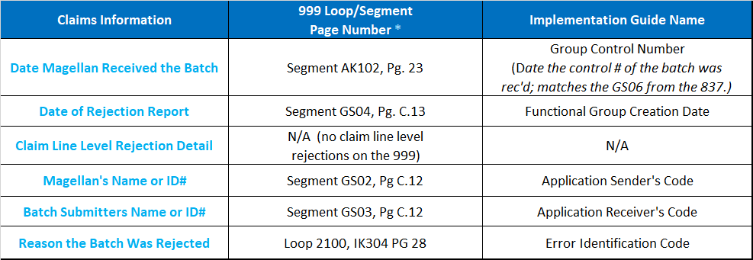
Important Information
Contained on the 999
* To access the 999 Technical Report please reach out to X12.org
https://x12.org/products/technical-reports

Slide 7
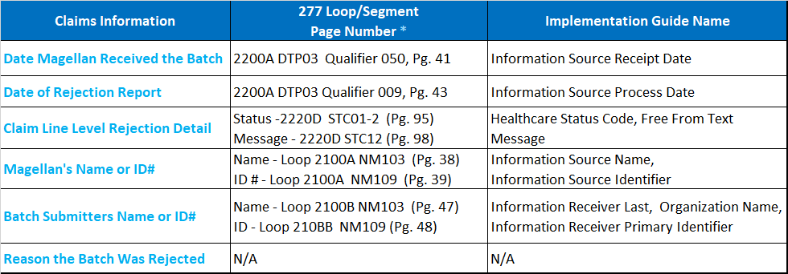
Important Information
Contained on the 277
* To access the 277 Technical Report please reach out to X12.org
https://x12.org/products/technical-reports

Slide 8
Claims Submissions

Slide 9
Claims Filing Procedures
Magellan reimburses mental health and substance abuse treatment providers using fee schedules for professional services. Magellan’s professional reimbursement schedules include the most frequently utilized HIPAA-compliant procedure codes for professional services.
Magellan provider contracts for LA CSoC require claims to be submitted within 365 days of the provision of covered services. Magellan will deny claims not received within timely filing limits.

Slide 10
Claims Filing Procedures (con’t)
A claim must contain no defect or impropriety, including a lack of any required substantiating documentation, HIPAA-compliant coding or other particular circumstance requiring special treatment that prevents timely payments from being made. If the claim does not contain all required information, it may be denied. Magellan does not pay for sessions that a member fails to attend, and the provider may not bill Magellan or covered payers for such sessions or services.
Members may not be billed in excess of the applicable network fee schedule for such services.
Magellan considers all payments final unless a claims appeal from the provider is received within 30 days of payment, subject to state and federal regulatory requirements.

Slide 11
What is a “Clean Claim”?
Clean Claim Definition:
A clean claim has no defect, impropriety or special circumstance, including incomplete documentation that delays timely payment. A provider submits a clean claim by providing the required data elements on the standard claims forms, along with any attachments and additional elements, or revisions to data elements, attachments and additional elements, of which the provider has knowledge.
Claims for inpatient and facility programs and services are to be submitted on the UB-04 and claims for individual professional procedures and services are to be submitted on the CMS- 1500. State guidelines may supersede these requirements. In addition, claims may be submitted electronically through a contracted clearinghouse or on Magellan’s web- based claims submission application. Magellan does not typically, but may require attachments or other information in addition to these standard forms (as noted below). Magellan may request treatment records for review.
Required clean claim elements: The Centers for Medicare and Medicaid Services (CMS) developed claim forms that record the information needed to process and generate provider reimbursement. The required elements of a clean claim must be complete, legible and accurate.

Slide 12
What is a “Clean Claim”? (Con’t)
CMS-1500
In the following line item description, the parenthetical information following each term is a reference to the field number to which that term corresponds on the CMS-1500 claim form. For more information about the CMS-1500 form, visit the National Uniform Claim Committee’s website. Note that Magellan can only accept the current version of the CMS-1500 form.
Subscriber’s/patient’s plan ID number (field 1a); Patient’s name (field 2); Patient’s date of birth and gender (field 3); Subscriber’s name (field 4); Patient’s address (street or P.O. Box, city, zip) (field 5); Patient’s relationship to subscriber (field 6); Subscriber’s address (street or P.O. Box, City, Zip Code) (field 7); Whether patient’s condition is related to employment, auto accident, or other accident (field 10); Subscriber’s policy number (field 11); Subscriber’s birth date and gender (field 11a); HMO or preferred provider carrier name (field 11c); Disclosure of any other health benefit plans (field 11d); Patient’s or authorized person’s signature or notation that the signature is on file with the physician or provider (field 12); Subscriber’s or authorized person’s signature or notation that the signature is on file with the physician or provider (field 13); Date of current illness, injury, or pregnancy (field 14); First date of previous, same or similar illness (field 15); Name of referring provider or other source (field 17); Referring provider NPI number (field 17b); Diagnosis codes or nature of illness or injury (current ICD-10 codes are required effective 10/1/15) (field 21); Date(s) of service (field 24A); Place of service codes (field 24B); EMG – emergency indicator (field 24C); Procedure/modifier code (current CPT or HCPCS codes are required) (field 24D); DX Pointer – diagnosis code (ICD-10 codes are required effective 10/1/15) by specific service (field 24E); Charge for each listed service (field 24F); Number of days or units (field 24G); Rendering provider NPI (field 24J); Physician’s or provider’s federal taxpayer ID number (field 25); Total charge (field 28); Signature of physician or provider that rendered service, including indication of professional license (e.g., MD, LCSW, etc.) or notation that the signature is on file with the HMO or preferred provider carrier (field 31); Name and address of facility where services rendered (if other than home or office) (field 32); The service facility Type 1 NPI (if different from main or billing NPI) (field 32a); Physician’s or provider’s billing name and address (field 33); and Main or billing Type 1 NPI number (field 33a).

Slide 13
What is a “Clean Claim”? (Con’t)
UB-04
The UB-04 form captures essential data elements for providers of services in institutional/inpatient/facility settings. The form can be used to bill Medicare fiscal intermediaries, Medicaid state agencies and health plans/insurers. The required elements of a clean claim must be complete, legible and accurate. For more information about the UB-04 form, visit the National Uniform Billing Committee’s website. Contact your claim forms vendor for full-color versions of the UB-04. In the following line item description, the parenthetical information following each term is a reference to the field number to which that term corresponds on the UB-04 claim form.
Provider’s name, address and telephone number (field 1); Patient control number (field 3a); Type of bill code (field 4); Provider’s federal tax ID number (field 5); Statement period (beginning and ending date of claim period) (field 6); Patient’s name (field 8); Patient’s address (field 9); Patient’s date of birth (field 10); Patient’s gender (field 11); Date of admission (field 12), required for inpatient and home health; Admission hour (field 13); Type of admission (e.g. emergency, urgent, elective, newborn) (field 14), required for inpatient; Source of admission code (field 15); Patient-status-at-discharge code (field 17); Value code and amounts (fields 39-41); Revenue code (field 42); Revenue/service description (field 43); HCPCS/Rates (current CPT or HCPCS codes are required) (field 44); Service date (field 45), (required for each date of facility-based non-inpatient services or itemization in a separate attachment is required); Units of service (field 46); Total charge (field 47); HMO or preferred provider carrier name (field 50); Main NPI number (field 56); Subscriber’s name (field 58); Patient’s relationship to subscriber (field 59); Insured’s unique ID (field 60); Diagnosis qualifier (field 66); Principal diagnosis code (ICD-10 codes are required effective 10/1/15) (field 67); Admit diagnosis (field 69); Provider name and identifiers (field 76-79).
Situational Clean Claim Elements are outlined in the embedded document.

Slide 14
What is an Incomplete Claim?
A claim is, generally, considered incomplete or deficient for the following reasons:
The claim does not comply with federal and state standards (e.g., clean claim
laws);
The claim does not contain one of the following data elements:
        diagnosis code;
        treating provider information;
        date of service;
        service type or procedure code;
        enrollee's name; and/or
        billed charge.
When a claim is determined to be deficient, Magellan renders a denial.

Slide 15
Provider Responsibilities…
Contact Magellan prior to rendering care, if the member’s benefit plan requires authorization for the service.
Complete all required fields on the CMS-1500 or UB-04 form accurately.
Collect applicable co-payments or co-insurance from members.
Submit a clean claim for services rendered, including your usual charge amount.
Submit claims for services delivered in conjunction with the terms of your agreement with Magellan.
Use only standard codes sets as established by CMS or the state of your licensure for the specific claim form (UB-04 or CMS-1500) you are using.

Slide 16
Provider Responsibilities (con’t)
Submit claims within 365 days of the provision of covered services.
Contact Magellan for direction if authorized services need to be used after the authorization has expired.
Do not bill the patient for any difference between your Magellan contracted reimbursement rate and your standard rate. This practice is called “balance billing” and is not permitted by Magellan.
Refer to the “Dos” and “Don’ts” of claims filing in the Appendix.
Refer to the Louisiana Department of Health for information on members’ Plan information. For claim information:
1. Go to www.MagellanProvider.com.
2. Securely sign in with your username and password. (Click Forgot Password? or Forgot Username? if you need to obtain your website sign-in.)

Slide 17
Provider Responsibilities (con’t)
3. Click “Lookup Contact Info” from the left-hand menu.
4. Enter the appropriate plan name to access information on plan, claims and appeals information. Here you will find the claims P.O. Box number for the member’s plan. The claims P.O. Box number is required for electronic claims as well as paper claims.
Contact the Customer Service number indicated on the member’s ID card for assistance. File any claims appeal within 30 days of payment for consideration.

Slide 18
Claims Receipt and Storage…
Paper Claims
Upon receipt, paper claims are logged, sorted into batches, imaged, assigned a Document Control Number (that reflects the received date) and data entered.
As part of our loss prevention efforts, Magellan reconciles the number of claims in its claims imaging system to the number of claims in its claims system and resolves any discrepancies.
Electronic Claims
The 999 transaction file confirms receipt of electronic claims.
As part of our loss prevention efforts, Magellan reconciles its claims inventory through daily pend and aging reports.

Slide 19
Appendix

Slide 20
Claims Tips - “Dos”
Do Give Complete Information on the Member and Policy Holder
Please provide complete information, such as the name, birth date and sex of the patient and give the policyholder name, relationship to the patient and policy information. Verify that this information matches the patient’s insurance card; membership can also be verified through Medicaid directly. Watch out for name variations and changes. Errors and omissions of these items can cause an unnecessary delay in processing the claim.
Do Give Complete Information on You, the Provider
Please provide complete provider information, including the names of both the rendering provider and the billing entity. The Taxpayer Identification Number (TIN) or Social Security Number and National Provider Identifier (NPI) must be included for the rendering provider in order to process and report claims accurately. In addition, the TIN and the NPI for the billing entity must be provided for the claim to be processed correctly. The billing or remittance address must be accurate for the check and/or Explanation of Benefits to be sent to the correct party. And, the degree level of the provider of service is needed to determine reimbursement amounts.

Slide 21
Claims Tips - “Dos” (Con’t)
Do Include Any Other Carrier's Payment Information
If another health plan is the primary insurer, and benefits have been provided or denied, include the primary insurer’s payment information in compliance with Coordination of Benefits rules.
Do Include Complete Diagnosis Information
If the patient has more than one diagnosis, please be sure to report all diagnoses on the claim. In addition, the Diagnosis Pointer field on the CMS-1500 form is required to indicate which billed diagnosis code relates to the service. Submitted diagnosis codes must be HIPAA-compliant, including the additional 5-7 digits, when required.
Do Obtain Authorization for Services
Most benefit plans require authorization prior to rendering services. Please verify with the member’s benefit plan if you are not sure if authorization is required. Billed services must match the authorization in order for the claim to be eligible for payment.

Slide 22
Claims Tips - “Dos” (Con’t)
Do Show Your Entire Charge
Always show your full charge on the claim. The amount that is reimbursed is based on the lesser of billed charges or the applicable reimbursement schedule.
Do Submit Your Claims Electronically and Within Timely Filing Guidelines
Submit your claims in the HIPAA compliant ASC X12 837 format within 365 days of the Covered Service directly to Magellan, or through a Magellan preferred clearinghouse.
Do Monitor Your EDI Transaction Reports
Monitor your EDI transaction reports on a regular and timely basis, and correct rejected claims.

Slide 23
Claims Tips - “Don’ts”
Don’t Use Invalid Procedure or Diagnosis Codes
Only use current code sets (CPT, HCPCS, Revenue and ICD) and select the code and diagnosis that most accurately describes the service provided. For diagnosis codes, be sure to use ICD-10 codes for services provided on or after 10/1/15. (ICD-9 diagnosis codes must be used for dates of service prior to 10/1/15.) Claims cannot be altered by our claims examiners; therefore an invalid code may result in denial of your claim.
Don’t Reduce Your Charge by the Co-Payment or Co-Insurance Amounts Paid by the Member
Always show your full charge on the claim. The amount that is reimbursed is based on the lesser of the billed charge or the applicable fee schedule.
Don't Omit Information on the Claim Because You’ve Already Provided It on the Treatment Plan
For confidentiality purposes, claims examiners do not have access to member Treatment Record Review forms; therefore, it is necessary for you to give information on the claim that you may have already provided as part of the treatment plan. To assist with prompt claims processing, please be sure to provide all information required on the claim form.

Slide 24
Most Frequent Reasons for Claims
Non-Payment
For your reference, the most frequent reasons for claims denial, include:
Duplicate claim submission (i.e., the expense was previously considered);
No preauthorization was obtained by the provider;
The member is ineligible, or coverage has lapsed;
Untimely claim submission/filing;
UB-04 claim does not follow correct coding requirements;
The primary insurance carrier’s EOB or the member’s COB form is needed;
The claim includes a non-covered diagnosis or service.

Slide 25
Sources and Related Material
1EDI Source @ https://www.1edisource.com/resources/edi-transactions-sets/edi-277/ and https://www.1edisource.com/resources/edi-transactions-sets/edi-999/
EDI Health Care Claims Acknowledgment Guide (277)
EDI Implementation Acknowledgment For Health Care Insurance (999)
Magellan of Louisiana will review the procedures contained within this document, on an annual basis, and post an updated version to https://www.magellanoflouisiana.com/for-providers/provider-toolkit/provider-resources/

Slide 26
Confidentiality Statement
By receipt of this presentation, each recipient agrees that the information contained herein will be kept confidential and that the information will not be photocopied, reproduced, or distributed to or disclosed to others at any time without the prior written consent of Magellan Health, Inc.
The information contained in this presentation is intended for educational purposes only and is not intended to define a standard of care or exclusive course of treatment, nor be a substitute for treatment.
Notes:
for educational presentations

